Slide 1
Department of Information Technology
A.P. Shah Institute of Technology G.B.Road,Kasarvadavli, Thane(W), Mumbai-400615
UNIVERSITY OF MUMBAI
Academic Year 2019-2020

Slide 2
Students Helping System
A Project Report on
Submitted in partial fulfillment of the degree of
Bachelor of Engineering(Sem-7) in
INFORMATION TECHNOLOGY
By
Nilesh Yadav (16104035)
Viraj Ghag (16104024)
Amol Beldar (16104070)
Under the Guidance of
Mr.Ganesh Gourshette &
Mrs.Geetanjali Kalme

Slide 3
1.Project Conception and Initiation

Slide 4
1.1 Abstract
The purpose of this project is to provide the colleges with an interactive machine for different activities going on in the colleges. The students will be able to know, ask complaint etc about what all activities colleges is doing for the students. Also we can provide students to give there suggestions or requests for particular activities that the students may require on college/departmental or personal basis as well. We will be making a website for an online complaint management system where the issues of the student can be registered online and will be resolved by the college authorities. This web application can reduce the gap between the student and the college staff as all the requests, complaints suggestions etc will be confidential and only the authorised person or the person who is intended to the requests can be able to view it.

Slide 5
1.2 Objectives
The main objective behind building this project is to reduce the communication gap between the students and the college authorities and also help in creating a techno friendly environment and save time.
With the use of the kiosk students can be able to convey there problems without
hesitating to the college officials.
Students will also be able to apply/request for some important college applications/credentials as well (eg. Bonafide certificate,Consetion forms etc).

Slide 6
1.3 Literature Review
1) Kaur, Harpreet, and Sonali Malhotra. "Use of “Kiosks” as a Self Service Tools in Libraries." 2018 5th International Symposium on Emerging Trends and Technologies in Libraries and Information Services (ETTLIS). IEEE, 2018[1].
In this paper Kiosks is been used as a self service tool in the library where all the basic work in the library is carried out with the help of the kiosk thus enhancing the efficient services and also helping to reduce the burden and stress of the staff for maintaining the library and helping the library to work better and also to think of it in a different manner.

Slide 7
2) Kansuwan, T., & Chomsiri, T. (2019). Authentication Model using the Bundled CAPTCHA OTP Instead of Traditional Password. 2019 Joint International
Conference on Digital Arts, Media and Technology with ECTI Northern Section Conference on Electrical, Electronics, Computer and Telecommunications Engineering
In this paper they have presented an idea of verifying the user by using “BUNDLED CAPTCHA OTP” for user verification instead of using old traditional passwords. It includes the use of CAPTCHA and one time password for reducing further processing steps and also user will not have to remember his password. It is a unique random parameter which will be used instead of traditional password method

Slide 8
1.4 Problem Definition
Not being able to convey the problems or avail the college provided services in a correct way may lead to degradation of the infrastructure of the college environment. If the authorities didn’t understand the problems students are facing or the extra services the students desire for their betterment the college won’t be able to progress in a right way and also with the pace they expect. So with the help of the STUDENTS HELPING SYSTEM the students can convey their problems in a better and secure way to the college authorities which will be completely confidential between the sender and the receiver and thus helping the college know the students requirements and problems and helping to progress in a faster pace

Slide 9
1.5 Scope
The scope of the project for further advancement can be using it for the purpose of navigation or to knowing about the details of the labs or extra courses or upcoming events which will be held in the institutes or outside institute.

Slide 10
1.6 Technology stack
HTML5
CSS
PHP
MYSQL Database
Java Script

Slide 11
1.7 Benefits for Environment & Society
By implementing this project it would help the college to progress and develop at a faster level as all the complaints and requests which the students were not able to convey before to the faculty or staff directly can be conveyed easily in a secure & authenticated manner thus helping the college to know students requests and difficulties leading to betterment of college in its overall development.

Slide 12
2. Project Design

Slide 13
2.1 Proposed System
In the proposed system, the students will be able to convey there problem, feedback,requests to the college using the STUDENT HELPING SYSTEM which will be implemented in the college. The students will need to login into the system through their unique login credentials provided to them by the admin.Once the student logins into the system he/she can convey his/her problems or even request his needs to the authorities in a secure and confidential way. Thus saving time and manpower.Also this requests and complaints will be known only to the students andthe person to whom it is intended thus no one can make changes into the messages been addressed.

Slide 14
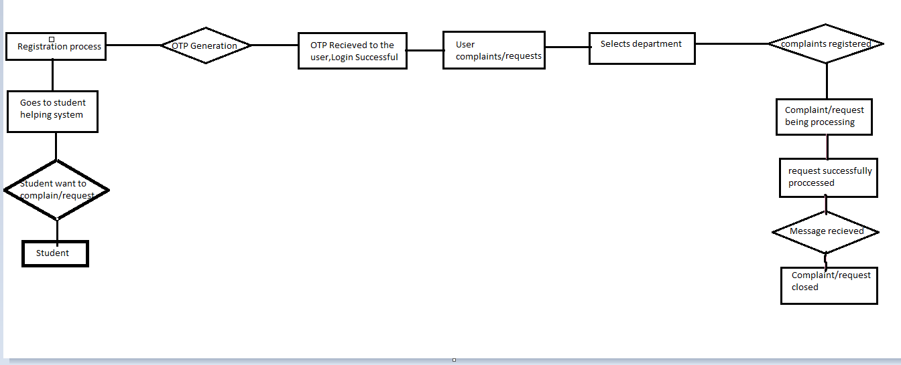
2.2 Design(Flow Of Modules)

Slide 15
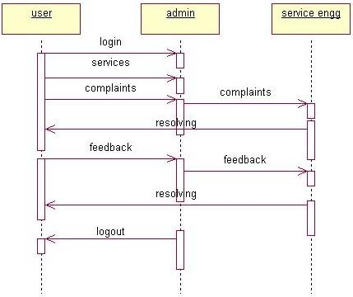
2.3 Description Of Use Case

Slide 16
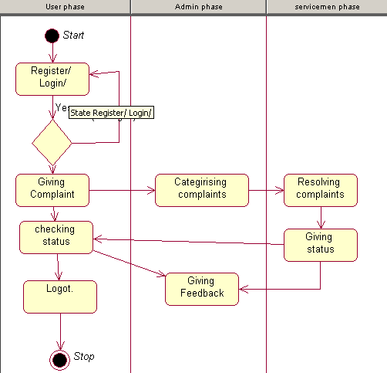
2.4 Activity diagram

Slide 17
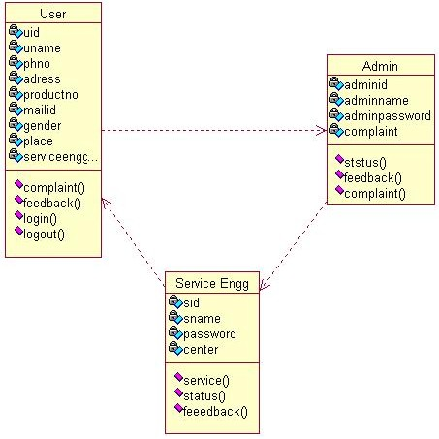
2.5 Class Diagram

Slide 18
2.6 Module-1 Admin Functions
Management of the database
Admin can manage users
Have to response for student’s complain /request /query
Update the status of complain /request /query
Admin can also upload the document for response
Forward complain /request /query to respective department
User monitoring.

Slide 19
Module-2 User Functions
Register and Login to the system
Update the profile
User can lodge complain /request /query with the uploadation of related document
Able to see the progress of complain /request/query

Slide 20
2.7 References
Kaur, Harpreet, and Sonali Malhotra. "Use of \ Kiosks" as a Self Service Tools in Li-braries." 2018 5th International Symposium on Emerging Trends and Technologies in Libraries and Information Services (ETTLIS). IEEE, 2018
Kansuwan, T., Chomsiri, T. (2019). Authentication Model using the Bundled CAPTCHA OTP Instead of Traditional Password. 2019 Joint International Conference on Digital Arts, Media and Technology with ECTI Northern Section Conference on Electrical, Electronics, Computer and Telecommunications Engineering
Si, Nong, Ke-Bin Jia, and Chang Xu. "A Networked Multimedia Distributed Kiosk System for Commercial and Home Appliances." 2016
Third International Conference on Computing Measurement Control and Sensor Network (CMCSN). IEEE, 2016.
Erdem, E., & Sandikkaya, M. T. (2018). OTPaaS —One Time Password as a Service. IEEE Transactions on Information Forensics and Security.
Kassim, R. A., Johari, J., Rahim, M. I., & Buniyamin, N. (2017). Lecturers’ perspective of student online feedback system: A case study. 2017 IEEE 9th International Conference on Engineering Education (ICEED).
Srivastava, S., & Sivasankar, M. (2016). On the generation of alphanumeric one time passwords. 2016 International Conference on Inventive Computation Technologies (ICICT)

Slide 21
3.Planning for next semester

Slide 22
Planning
The planning for next semester will be working on and implementing verification & authentication of OTP through SMS as well as email.
Insertion of various useful documents on the site eg: Bonafide Certificate.
Merging sms server with the website.

Slide 23
Thank You

